Slide 1
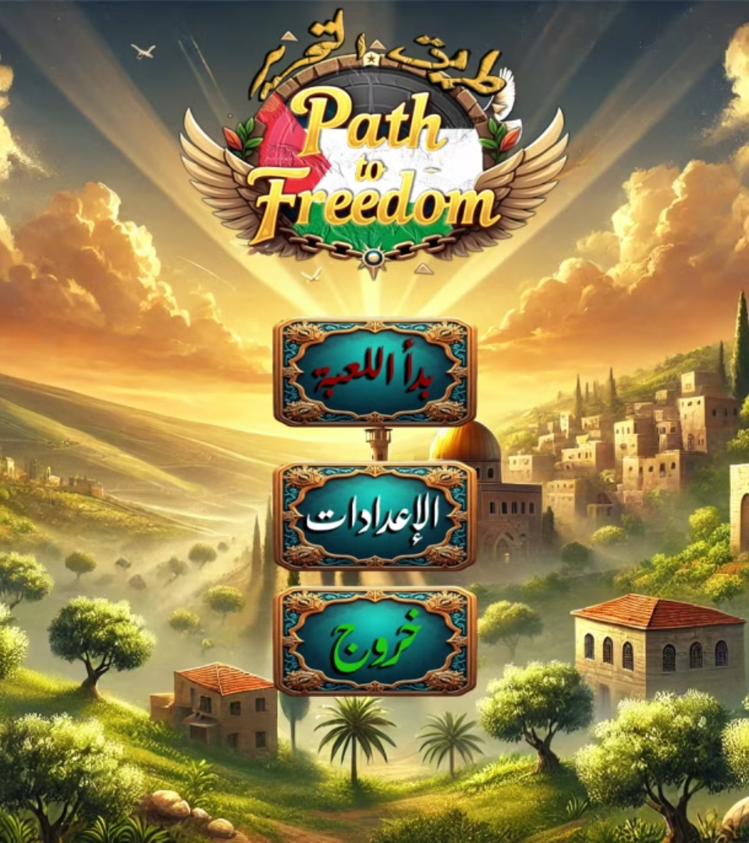

Path to Freedom ""طريق التحرير
Final Project for Serious Gaming Fundamentals
Developed by:
Anas Al Sayed-1221020
Abd Al-Rheem Yaseen-1220783
Rakan Omar-1221334
Special Thanks:
Dr. Rashid Jiyousi

Slide 2
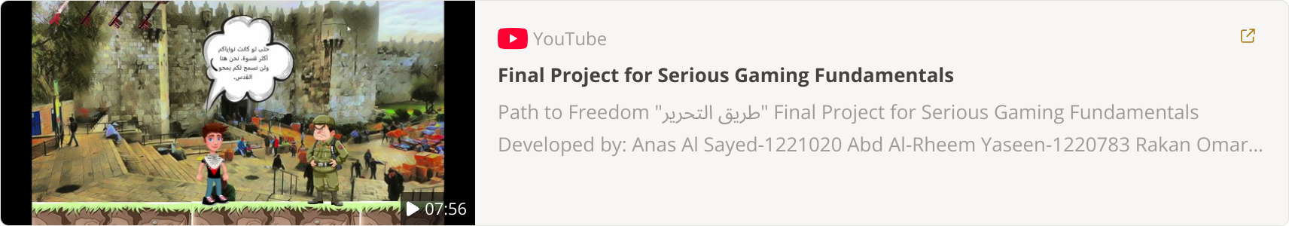
Game review video

Slide 3
Game Concept & Goals
Game Idea
Scenario
Educates players about occupied Palestinian cities' history, emphasizing freedom and defending one's land.
The liberation of Palestine is achieved through the power of knowledge and understanding,through historical and geographical questions..
Motivations
Main Objective
This game aims to educate players about the rich history of Palestinian cities and foster a sense of connection with their stories. Through interactive gameplay.
Raise awareness of Palestinian heritage and culture interactively. Inspire players to value education and critical thinking for liberation.

Slide 4
Game Design Document (GDD)
Game Overview
1
Title: Liberation of Palestine
Genre: Educational, Adventure
Platform: PC
Target Audience & Gameplay
2
Target Audience: Young adults and gamers interested in history and culture
Gameplay Style: Single-player, Story-driven
Game Concept & Storyline
An educational and interactive game where players navigate through historically significant Palestinian cities. The game combines exploration, challenges, and multiple-choice questions to build knowledge and awareness. Players assume the role of a young Palestinian protagonist on a journey to reclaim cities occupied in their homeland. Through encounters with historical landmarks, they learn about the resilience of their people and gather tools for liberation—knowledge, heritage, and hope.
3

Slide 5






Gameplay Mechanics: Informative and Interactive
Navigate using keyboard arrows
Interact using Mouse
Answer multiple-choice questions
Avoid obstacles (walls, checkpoints)
Collect "Keys of Return" for correct answers
Progress
Advance to the next city after answering correctly.
Receive hints or replay challenges after wrong answers.

Slide 6
UI Design And Audio
Characters:
Maps and Themes:
Audio:
Main Character: A Palestinian youth wearing a traditional keffiyeh.
Each city has a unique map and background and theme aligned with its history.
Background Music:Traditional Palestinian music and character voiceovers for each stage.
Enemies: Represented as Israeli soldiers and settlers.
Palestinian icons like the keffiyeh, Dome of the Rock, and Keys of Return.
Sound Effects: Ambient sounds, interactions with checkpoints, and character voiceovers.

Slide 7
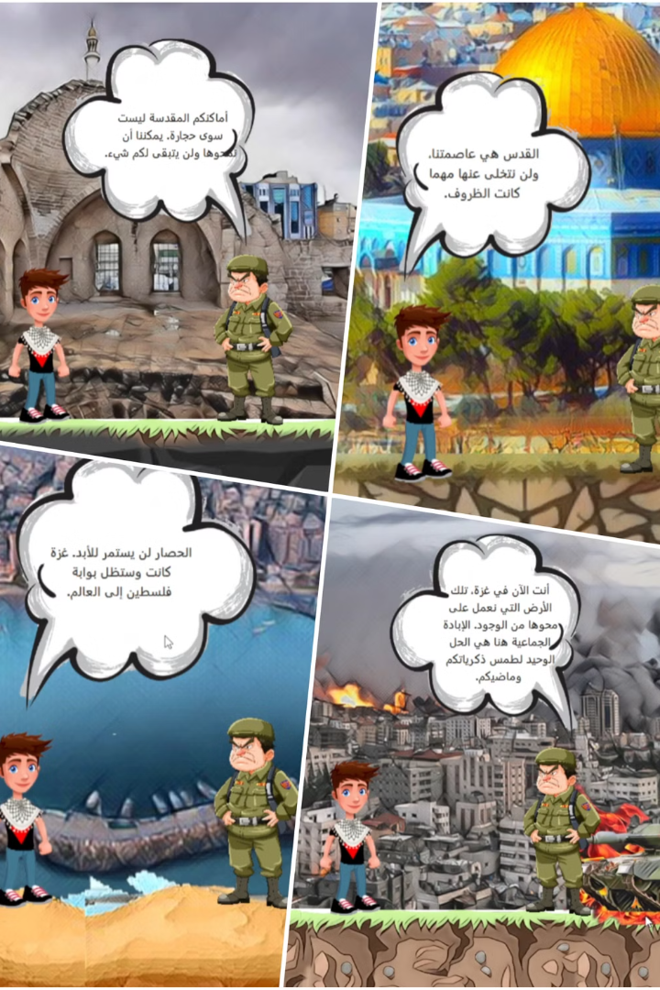
Story and Interaction
1
The game features a dynamic storyline where characters interact.
2
Dialogues between the protagonist and enemies add suspense and context to each stage.
3
Multiple choice questions on historical, cultural and geographical topics appear for each stage.
4
Scenarios develop alongside the game’s progress to maintain player engagement.

Slide 8
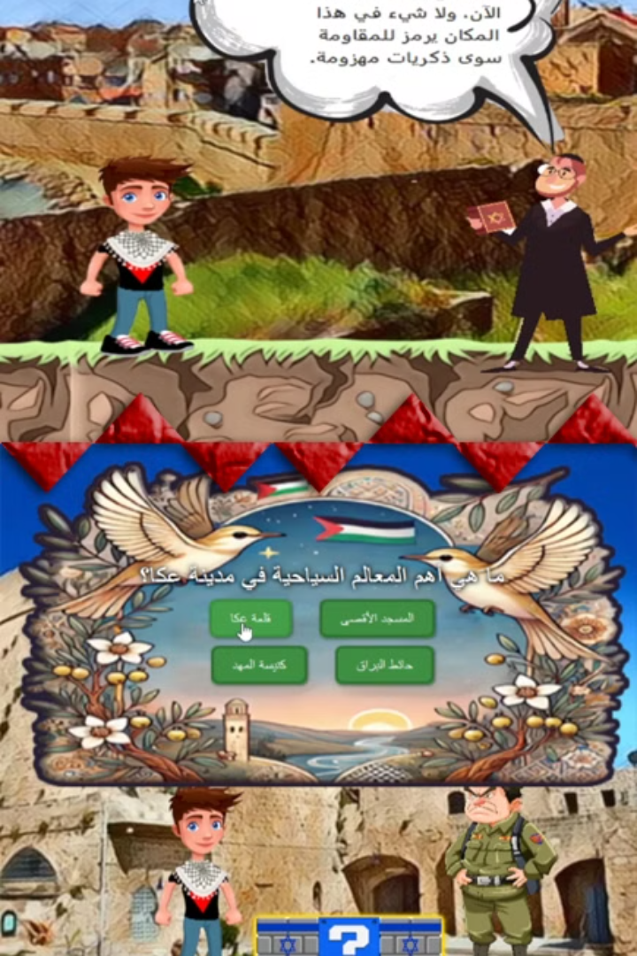



Level 1: Exploring Ancient Akka
Historical Landmarks
Exploring the City's Treasures
Players will embark on a journey through the streets of Akka, encountering its most famous sites such as its ancient walls, the port, and old markets.
Players will use a map to navigate through the city, discovering hidden treasures and engaging with interactive elements that reveal historical facts about Akka.
Learning
Players will answer questions such as:
What are Akka's most famous landmarks?
What makes Akka's ancient walls unique?
What is one of the traditional professions Akka was known for in the past?
Correct answers will help players progress through the level while fostering a deeper appreciation of Akka's rich heritage.

Slide 9
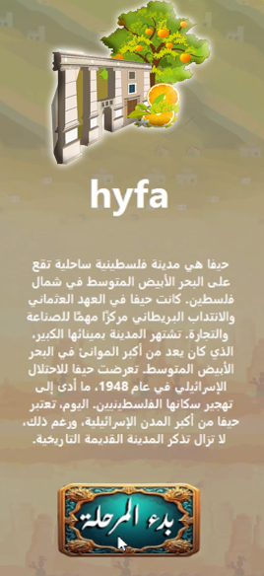
Level 2: Navigating the Streets of Haifa
1
Exploring the City
Players will encounter bustling markets, vibrant street scenes, and historical landmarks. They will learn about the city's diverse culture and its role in Palestinian history.
2
Facing Challenges
Players will have to overcome obstacles, such as roadblocks and checkpoints, symbolizing the challenges faced by Palestinians in their daily lives.
3
Learning about Resistance
To progress, players will answer questions like:
What is the famous garden that is one of Haifa's main attractions?
What nickname is Haifa known by?
Correct answers will unlock pathways, allowing players to dive deeper into the cultural and historical essence of Haifa.

Slide 10



Level 3: Defending the Resilience of Gaza
Discovering Gaza's Rich History
Players will explore key landmarks in Gaza, such as the Great Omari Mosque, one of the oldest mosques in the region, and learn about Al-Azhar University, a prominent educational institution. Along the way, they will uncover stories of resilience and cultural pride that define the people of Gaza.
1
Challenges
2
Set in a war-torn environment, players will navigate the ruins of Gaza while learning about the city's strategic significance, including its two main ports, Gaza Seaport and Khan Younis Port. They will also learn about recent events, such as the military operation that began in 2023, and how these shaped the city's history.
Hope
To advance in this level, players will face questions such as:
What is the name of the military operation that began in Gaza in 2023?
3
What are the two main seaports of Gaza?
What is the name of one of Gaza’s oldest mosques?
What is the name of the prominent university in Gaza?

Slide 11
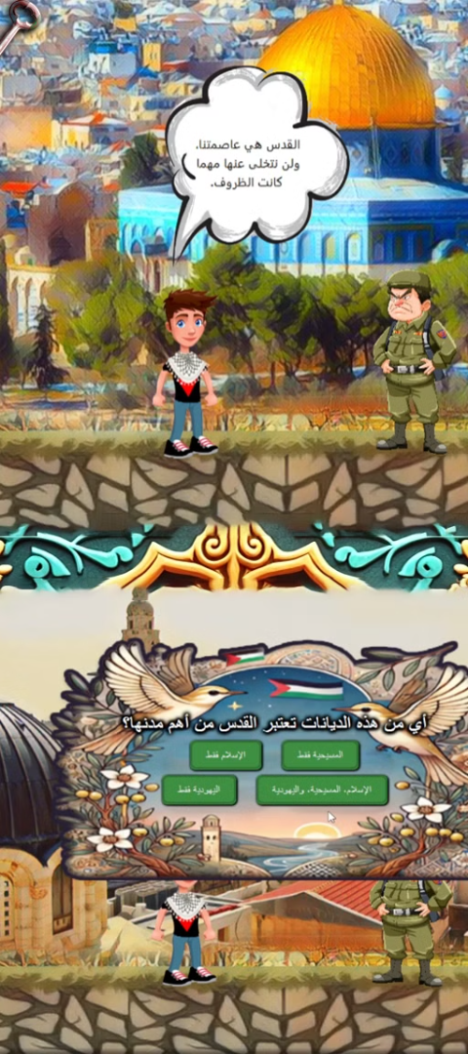



Level 4: Liberation of Jerusalem
Historical Significance
Players will explore the sacred sites of Jerusalem, understanding its cultural and religious importance to both Palestinians and other communities.
Struggles and Resistance
Players will witness the ongoing struggles of Palestinians in Jerusalem and their fight for self-determination and freedom.
Hope for the Future
The level will culminate in a message of hope and the pursuit of a peaceful and just resolution for Jerusalem, a symbol of unity and shared heritage.

Slide 12
Prototyping and Testing:
1
Prototyping
Built basic navigation and mechanics to ensure smooth gameplay.
2
Quality Assurance (QA) Testing
Testing for bugs and refining gameplay.
3
Beta Testing
Feedback from Palestinian communities.

Slide 13
Development Timeline
Conceptualization
1
2 weeks
2
Prototype Development
3 weeks
Production
3
10 weeks
4
Testing
4 weeks
Launch Preparation
5
1 week

Slide 14
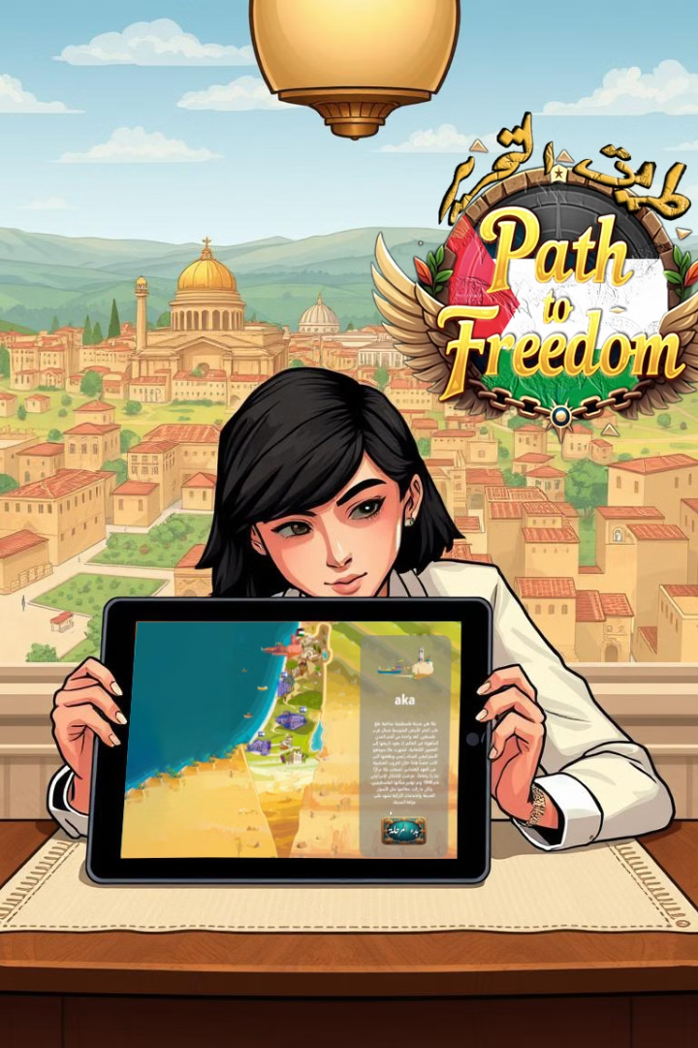
Pre-Launch (Polishing & Marketing)
1
2
Feedback
Testing
Gather feedback from Palestinian communities and cultural experts to ensure the game accurately represents Palestinian history and culture.
Conduct thorough testing to ensure gameplay is engaging, informative, and accessible to a wide audience.
3
Marketing
Develop a marketing strategy that highlights the game's educational value and cultural significance to reach a diverse audience.

Slide 15
Challenges and Achievements
50%
90%
Challenges Faced:
Achievements
Balancing historical accuracy with engaging gameplay.
Successfully integrated education into an interactive game.
Designing a culturally authentic experience.
Created an immersive experience highlighting Palestinian heritage.

Slide 16



Conclusion: Why this Game Matters
Cultural Awareness
1
Promotes cultural understanding through interactive gameplay.
Knowledge as Liberation
2
Inspires players to value knowledge for freedom.
Future Enhancements
3
Expansion of cities, stages, multiplayer, and localization.

Slide 17
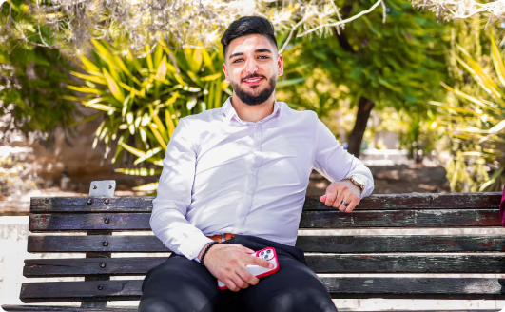

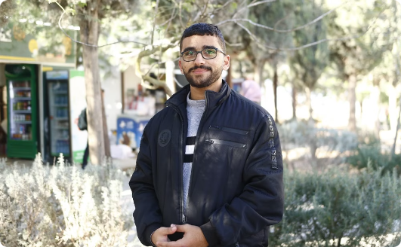
Team Contributions:
Anas Al Sayed
Abd Al-Rheem Yaseen
Rakan Omar
Interface design, character creation, sound design
Game programming and level design
Dialogue writing, question preparation, research
Special Thanks:
Dr. Rashid Jiyousi for his guidance and mentorship.

Slide 18
Thank You

